Slide 1
ASP.NET MVC

Slide 2
MVC
MVC separates the user interface of an application into three main aspects:
The Model
The View
The Controler

Slide 3
MVC
Model A set of classes that describes the data you’re working with as well as the business rules for how the data can be changed and manipulated
View Defines how the application’s UI will be displayed
Controller A set of classes that handles communication from the user, overall application flow, and application-specific logic.

Slide 4
MVC as Applied to Web Frameworks
Models:
Represent domain objects that encapsulate:
data stored in a database
code to manipulate the data
code to enforce domain-specific business logic
Example: encapsulating Entity Framework

Slide 5
MVC as Applied to Web Frameworks
View:
Template to dynamically generate HTML
Controller:
Class that manages the relationship between the View and the Model
It responds to user input, talks to the model, and decides which view to render (if any).

Slide 6
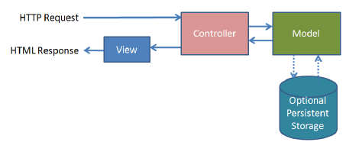

Slide 7
A Pattern
MVC is a pattern that can be applied to different frameworks
ASP.NET MVC
The MVC pattern has been applied to ASP.NET. This does not mean that it is the same as MVC running in other places.

Slide 8
ASP.NET MVC 3
10 months after MVC 2
The Razor view engine
Support for .NET 4 Data Annotations
Improved model validation
Greater control and flexibility with support for dependency resolution and global action filters
Better JavaScript support with unobtrusive JavaScript, jQuery Validation, and JSON binding
Use of NuGet to deliver software and manage dependencies throughout the platform

Slide 9
Razor View Engine
Code-focused templating for HTML generation
Compact, expressive, and fluid
Not a new language
Easy to learn
Works with any text editor
IntelliSense
No XML-like heavy syntax

Slide 10
ASP.NET MVC 4
Features include:
ASP.NET Web API
Enhancements to the default project templates
Mobile project template using jQuery Mobile
Display Modes
Task Support for Asynchronous Controllers
Bundling and Minification

Slide 11
ASP.NET Web API
Referred to as Web API
A framework that offers the ASP.NET MVC development style but is tailored to writing HTTP services. (service-oriented design)
Several MVC features have been adopted for HTTP Service domain:
Routing
Model Binding and Validation
Filters
Scaffolding
Easy Unit Testability

Slide 12
ASP.NET MVC 5
http://www.asp.net/mvc/mvc5

Slide 13
Layout of an MVC project
When you create a new MVC project, your solution should have the following structure in your Solution Explorer.

Slide 14
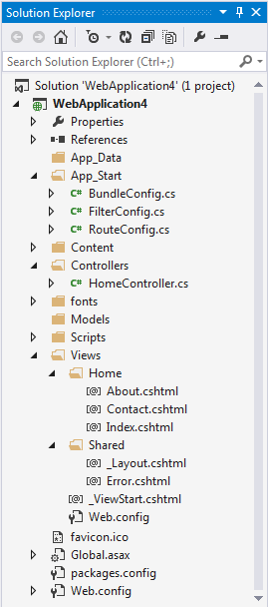
Layout of an MVC project

Slide 15
Layout of an MVC project
App_Data –it’s meant to hold data for your application (just as the name says). A couple of examples would include a portable database (like SQL Server Compact Edition) or any kind of data files (XML, JSON, etc.). I prefer to use SQL Server.
App_Start – The App_Start folder contains the initialization and configuration of different features of your application.
BundleConfig.cs – This contains all of the configuration for minifying and compressing your JavaScript and CSS files into one file.
FilterConfig.cs – Registers Global Filters.
RouteConfig.cs – Configuration of your routes.
There are other xxxxConfig.cs files that are added when you apply other MVC-related technologies (for example, WebAPI adds WebApiConfig.cs).
Content – This folder is meant for all of your static content like images and style sheets. It’s best to create folders for them like “images” or “styles” or “css”.

Slide 16
Layout of an MVC project
Controllers – The controllers folder is where we place the controllers.
Models – This folder contains your business models. It’s better when you have these models in another project, but for demo purposes, we’ll place them in here.
Scripts – This is where your JavaScript scripts reside.
Views – This parent folder contains all of your HTML “Views” with each controller name as a folder. Each folder will contain a number of cshtml files relating to the methods in that folder’s controller. If we had a URL that looked like this:
http://www.xyzcompany.com/Products/List
we would have a Products folder with a List.cshtml file. We would also know to look in the Controllers folder and open the ProductsController.cs and look for the List method.

Slide 17
Layout of an MVC project
Views/Shared – The Shared folder is meant for any shared cshtml files you need across the website.
Global.asax – The Global.asax is meant for the initialization of the web application. If you look inside the Global.asax, you’ll notice that this is where the RouteConfig.cs, BundleConfig.cs, and FilterConfig.cs are called when the application runs.
Web.Config – The web.config is where you place configuration settings for your application. For new MVC developers, it’s good to know that you can place settings inside the <appsettings> tag and place connection strings inside the <connectionstring> tag.

Slide 18
Controller
“Convention over configuration”
ASP.NET MVC is heavily convention-based
Uses Directory-naming structure when resolving view templates.
Allows you to omit the location path when referencing views from within a Controller class.

Slide 19
View
Each controller’s class name ends with Controller
LegalController, LegalServicesController, HomeController
One Views directory for all the views of your application
Views that controllers use live in a subdirectory of the Views main directory and are named according to the controller name(minus the Controller suffix)
Views for the LegalController would live in /Views/Legal
Reusable UI elements live in a similar structure, but in a Shared directory in the Views folder

Slide 20
Controller Basics
Model View Controller:
1st Controller basics, then the other stuff.
Have a look at the HomeController
Responsible for deciding what will happen when you browse to the homepage of the website.

Slide 21
The Controller’s Role
Responsible for responding to user input, making changes to the model in response to user input if needed.
Controllers are concerned with the flow of the application, working with data that comes in and providing data going out to the relevant view.

Slide 22
The Controller’s Role
The URL tells the routing mechanism (later chapter) which controller class to instantiate and which action method to call, and supplies the required arguments to that method.
The controller’s method then decides which view to use, and that view then renders the HTML.
The controller’s method could return something other than a view.

Slide 23
The Controller’s Role
There is a relationship between the URL and the METHOD on a controller class. Not a relationship between the URL and a FILE on the web server.
MVC serves up the results of method calls, not dynamically generated pages.
(More about routing in later)

Slide 24
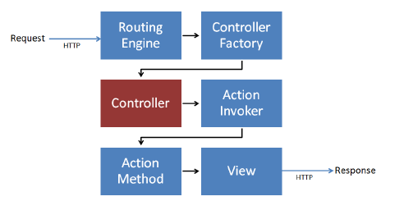
MVC Request processing pipeline

Slide 25
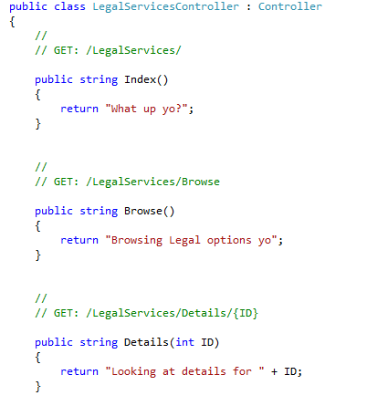
Modifying the LegalServicesController
The Browse and Details methods to cover additional scenarios.

Slide 26
Observation
Browsing to /LegalServices/Browse caused the browse method of the LegalServicesController to be executed.
NO extra configuration was needed.
This is routing in action. More later.
We returned text to the browser without a model or a view.

Slide 27
Oversimplified
The previous example was not common and was oversimplified.
You will almost always use Views
You will most often return ActionResult instead of strings
And routing is more complex that shown.

Slide 28
Mapping controller
Controller selection based on URL
Default URL routing logic:/[Controller]/[ActionName]/[Parameters]
Format for routing inApp_Start/RouteConfig.cs

Slide 29
URL routing
WebappURL without URL segments => HomeController::Index()
Index() –default method of a controller
/HelloWorld=> HelloWorldController
/HelloWorld/Index => HelloWorldController::Index()
http://webapp:port/HelloWorld/Welcome =>HelloWorldController::Welcome()

Slide 30
Parameters
/HelloWorld/Welcome?name=Scott&numtimes=4
Introducing 2 parameters to Welcome method
Parameters passed as query strings!

Slide 31
URL Parameters
http://webapp/HelloWorld/Welcome/3?name=Rick

Slide 32
Basic Controllers Summary
Controllers orchestrate the interactions of the user, the model objects and the views.
They are responsible for:
responding to the user input
Manipulating the appropriate model objects
And then selecting the appropriate view to display back to the user in response to the initial input

Slide 33
ActionResult
Before talking about Views, let’s look at ActionResults

Slide 34
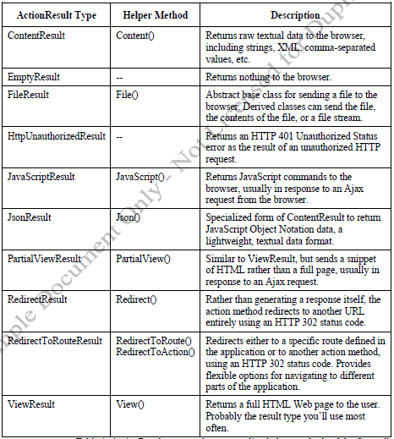
ActionResult type

Slide 35
The View
The user’s first impression of your site starts with the View
Responsible for providing the user interface to the user.
The view transforms a model into a format ready to be presented to the user.
The view examines the model object and transforms the contents to HTML

Slide 36
The View
Not all views render HTML, but HTML is the most common case
More info on alternate types of content later.
Views created using Razor view engine
Controller method returns View object
Controller method return type is ActionResult

Slide 37
Razor View Engine
What is Razor?
Introduced in ASP.NET MVC 3 and is the default view engine moving forward
Provides a clean, lightweight, simple view engine.
Provides a streamlined syntax for expressing views
Minimizes the amount of syntax and extra characters.

Slide 38

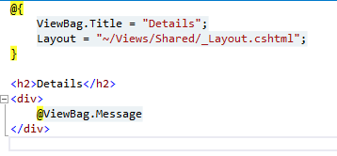
Example

Slide 39
Convention
The Views directory contains a folder for your controller, with the same name as the controller, but without the controller suffix.
HomeController has views in the Home directory
Within the view folder (also called controller folder) there’s a view file for each action method, named the same as the action method.
This is how views are associated to an action method.
An action method can return a ViewResult via the View() method.

Slide 40
View() Method
When the view name isn’t specified, the ViewResult returned by the action method applies a convention to locate the view.
It first looks for a view with the same name as the action within the /Views/ControllerName directory. “Ex: /views/home/Index.cshtml”
The View() method is overloaded. You can supply a view name to render a different view. “ex: View(“MyView”)”
It will still look in the same directory, but will look for the “MyView.cshtml” file.
View(“~/Views/DifferentDirectory/Index.cshtml”)
To get to a different directory, provide the full path to that directory. You must provide the file extension as well. This bypasses the internal lookup mechanism.

